Slide 1
Exception Handling
What are Exceptions ?
The traditional approach
Exception handling in Java
Standard exceptions in Java
Multiple catch handlers
Catching multiple exceptions
finally block
Try-with-resources statement
Checked vs unchecked exception
Stack trace
Assertion

Slide 2
What are Exceptions ?
We don’t live in a perfect world.
there are so many unexpected situations that cause our programs to behave different from our expectations.
The term exception is shorthand for the phrase “exceptional event”
An exception is an event, which occurs during the execution of a program, that disrupts the normal flow of the program’s instructions.
Examples of exceptions
Nonnumeric character is entered when an integer is expected.
No such file when a program tries to open a file.
Happen to divide integer by zero ➔ it may halt the program
No available memory space when memory allocation is requested by new.

Slide 3
What are Exceptions ?
When an error occurs within a method, the method creates an object and hands it off to the runtime system. The object, called an exception object, contains information about the error including
its type
the state of the program when the error occurred
Creating an exception object and handling it to the runtime system is called throwing an exception

Slide 4
What are Exceptions ?
After a method throws an exception, the runtime system attempts to find something to handle it. The set of possible “somethings” to handle the execution is the ordered list of methods (call stack)
When an appropriate handler is found, the runtime system passes the execution to the handler. An execution handler is considered appropriate if the type of the execution object thrown matched the type that can be handled by the handler.
The exception handler chosen is said to catch the exception.

Slide 5
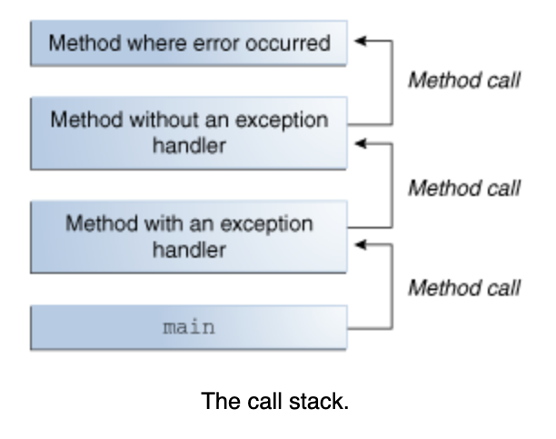
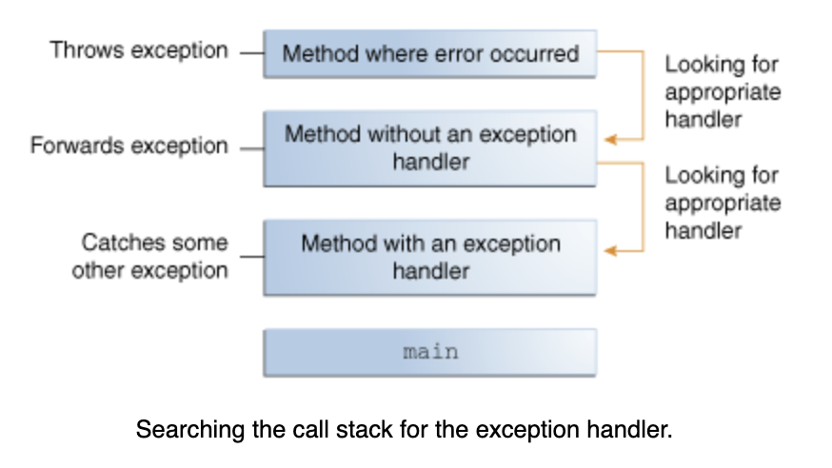
What are Exceptions ?
exception propagation
(예외 전파)

Slide 6
What are Exceptions ?
To prevent a program from abnormal behavior, we need to check every statement that could cause exceptions.
What exceptions should be considered in the following code ?
The array arr may point to null.
The index of i may not be within the valid range: 0 .. arr.length-1
The index of x may not be within the valid range: 0 .. arr.length-1
The value of z may be zero.
double badCode(int arr[], int i) {
int x = arr[i] ;
int z = arr[x] ;
return 1 / z ;
}

Slide 7
The Traditional Approach to Handling Exceptions
To prevent a program from abnormal behavior, we need to check every statement that could cause exceptions.
double badCode(int arr[], int i) {
if (arr == null ) { System.out.println("null array") ; return -1.0; }
if (i < 0 || i >= arr.length) {
System.out.printf("Array index %d is not valid%n", i); return -2.0;
}
int x = arr[i] ;
if (x < 0 || x >= arr.length) {
System.out.printf("Array index %d is not valid%n", x); return -3.0;
}
int z = arr[x] ;
if (z == 0) {
System.out.println("Error: Denominator is 0"); return -4.0;
}
return 1 / z ;
}

Slide 8
Problems with the Traditional Approach
Problem #1: Too much overhead for the exception handling codes
Problem #2: exception handling codes are interspersed with normal codes.
Problem #3: artificial codes are used to notify exceptional situations.
double badCode(int arr[], int i) {
if (arr == null ) { System.out.println("null array") ; return -1.0; }
if (i < 0 || i >= arr.length) {
System.out.printf("Array index %d is not valid%n", i); return -2.0;
}
int x = arr[i] ;
if (x < 0 || x >= arr.length) {
System.out.printf("Array index %d is not valid%n", x); return -3.0;
}
int z = arr[x] ;
if (z == 0) {
System.out.println("Error: Denominator is 0"); return -4.0;
}
return 1 / z ;
}

Slide 9
Exception Handling in Java
With try/catch block, we can separate the error checking codes from the normal code.
Exception handling in Java is similar to that in C++.
statements;
try {
error-prone code...;
}
catch (Exception-type1 e1) { code for dealing with e1 exception
}
catch (Exception-type2 e2) { code for dealing with e2 exception
}
more-statements;
Try block wraps the error-prone code
If an exception (error) occurs anywhere in the code inside the try block, the catch block is executed immediately
After the catch block (the catch handler) has finished, execution continues after the catch block

Slide 10
badCode with Exception Handling
public class ExceptionHandling_1 {
private static double badCode(int a[], int y) throws Exception {
try {
int x = a[y] ; // NullPointerException
int z = a[x] ;
return 1 / z ;
}
catch ( Exception e ) {
System.out.println("Exception occurred: " + e) ;
throw e ;
}
}
public static void main(String[] args) {
try { badCode(null, 10) ; }
catch ( Exception e) { System.out.println("badCode failed") ; }
}
}
Exception occurred: java.lang.NullPointerException
badCode failed

Slide 11
badCode with Exception Handling
public class ExceptionHandling_2 {
private static double badCode(int a[], int y) throws Exception {
try {
int x = a[y] ; // ArrayIndexOutOfBoundsException
int z = a[x] ;
return 1 / z ;
}
catch ( Exception e ) {
System.out.println("Exception occurred: " + e) ;
throw e ;
}
}
public static void main(String[] args) {
try { int[] a = {0, 1, 2} ; badCode(a, 3); }
catch ( Exception e) { System.out.println("badCode failed") ; }
}
}
Exception occurred: java.lang.ArrayIndexOutOfBoundsException:
Index 3 out of bounds for length 3
badCode failed

Slide 12
Standard Exceptions in Java
Many useful exceptions are defined as subclasses of RuntimeException class in Java.
They belong to java.lang package, not requiring importing
Exception | Description
NullPointerException | Thrown when an application attempts to use null in a case where an object is required
ArithmeticException | Thrown when an exceptional arithmetic condition has occurred; e.g.) divide by zero
ClassCastException | Thrown when an application attempts an illegal cast; for example Object x = new Integer(0); System.out.println((String)x);
ArrayIndexOutOfBounds Exception | Thrown to indicate that an array has been accessed with an illegal index

Slide 13
Trace with Exception: printStackTrace()
01: public class ExceptionHandling_3 {
02: private static double badCode(int a[], int y) throws Exception {
03: try {
04: int x = a[y] ; // throws ArrayIndexOutOfBoundsException
05: int z = a[x] ;
06: return 1 / z ;
07: }
08: catch (ArrayIndexOutOfBoundsException e) {
09: System.out.println("Exception occurred: " + e) ;
10: e.printStackTrace();
11: throw e ;
12: }
13: }
14: public static void main(String[] args) {
15: try { int[] a = {0, 1, 2} ; badCode(a, 3); }
16: catch (ArrayIndexOutOfBoundsException e) { System.out.println("badCode failed") ; }
17: }
18: }
You can trace the source of the exception by printStackTrace()
Exception occurred: java.lang.ArrayIndexOutOfBoundsException: 3
java.lang.ArrayIndexOutOfBoundsException: 3
at ExceptionHandling_3.badCode(ExceptionHandling_3.java:4)
at ExceptionHandling_3.main(ExceptionHandling_3.java:15)
badCode failed

Slide 14
Multiple Catch Handlers
import java.util.Scanner;
public class MultipleCatchHandlers {
public static void main(String[] args) {
try {
Scanner scanner = new Scanner(System.in) ;
int x = scanner.nextInt() ; // can throw java.util.InputMismatchException
int[] a = {-1, 0, 1, 2} ;
int y = a[x] ; // can throw ArrayIndexOutOfBoundsException
int z = a[y]/a[y]; // can throw ArrayIndexOutOfBoundsException and ArithmeticException
}
catch (ArithmeticException e) {
System.out.println("Arithmetic exception took place: " + e) ;
}
catch (ArrayIndexOutOfBoundsException e) {
System.out.println("Array index is invalid: " + e) ;
}
catch (java.util.InputMismatchException e) {
System.out.println("The given string cannot be converted into an integer: " + e) ;
}
}
}
Multiple catch blocks can be provided to handle different types of exceptions.

Slide 15
…
try {
Scanner scanner = new Scanner(System.in) ;
int x = scanner.nextInt() ; // (3) java.util.InputMismatchException
int[] a = {-1, 0, 1, 2} ;
int y = a[x] ;
int z = a[y] / a[x] ; // (1) ArrayIndexOutOfBoundsException, (2) ArithmeticException
}
catch (ArithmeticException e) {
System.out.println("Arithmetic exception took place: " + e) ;
}
catch (ArrayIndexOutOfBoundsException e) {
System.out.println("Array index is invalid: " + e) ;
}
catch (java.util.InputMismatchException e) {
System.out.println("The given string cannot be converted into an integer: " + e) ;
}
}
}
0
Array index is invalid: java.lang.ArrayIndexOutOfBoundsException: -1
1
Arithmetic exception took place: java.lang.ArithmeticException: / by zero
abc
The given string cannot be converted into an integer: java.util.InputMismatchException

Slide 16
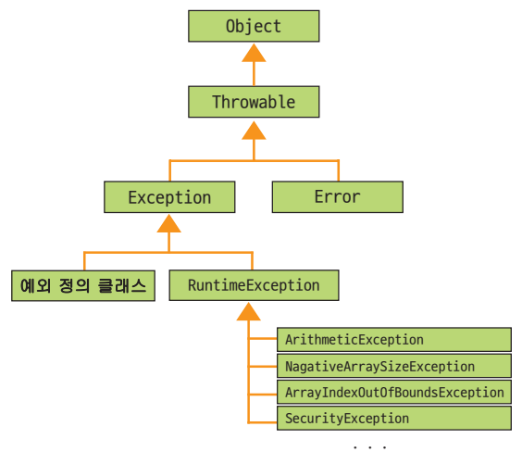
Catch Handler for Multiple Exceptions
Catch handler can catch all the exceptions of its own type and its descendants.
Exception
RuntimeException
ArithmeticException
User Defined Exception Class

Slide 17
import java.io.*;
public class CatchingMultipleExceptions {
public static void main(String[] args) {
try {
FileReader fin = new FileReader("employee.txt") ; // can throw FileNotFoundException
BufferedReader in = new BufferedReader(fin) ;
int i1 = Integer.parseInt(in.readLine()) ; // can throw NumberFormatException
int i2 = Integer.parseInt(in.readLine()) ; // can throw NumberFormatException
System.out.printf("%d %d%n ", i1, i2) ;
int[] a = {-10, 0, 10, 20} ;
System.out.println(a[i1] / a[i2]) ;
// can throw ArrayIndexOutOfBoundsException and ArithmeticException
}
catch (IOException e) { // can catch java.io.FileNotFoundException
System.out.println(e) ;
}
catch (RuntimeException e) {
// can catch ArrayIndexOutOfBoundsException, ArithmeticException, and NumberFormatException
System.out.println(e) ;
}
}
}
2 1
java.lang.ArithmeticException: / by zero
0 4
java.lang.ArrayIndexOutOfBoundsException: 4

Slide 18
The Most General Hander
catch (Exception e) { …
}
can catch any exception because Exception is the superclass of all exception types
import java.io.*;
public class CatchingMultipleExceptions {
public static void main(String[] args) {
try {
…
}
catch (Exception e) { System.out.println(e) ; }
catch (IOException e) { System.out.println(e) ; }
catch (RuntimeException e) { System.out.println(e) ; }
}
}
Exception in thread "main" java.lang.Error: Unresolved compilation problems:
Unreachable catch block for IOException.
It is already handled by the catch block for Exception
Unreachable catch block for RuntimeException.
It is already handled by the catch block for Exception

Slide 19
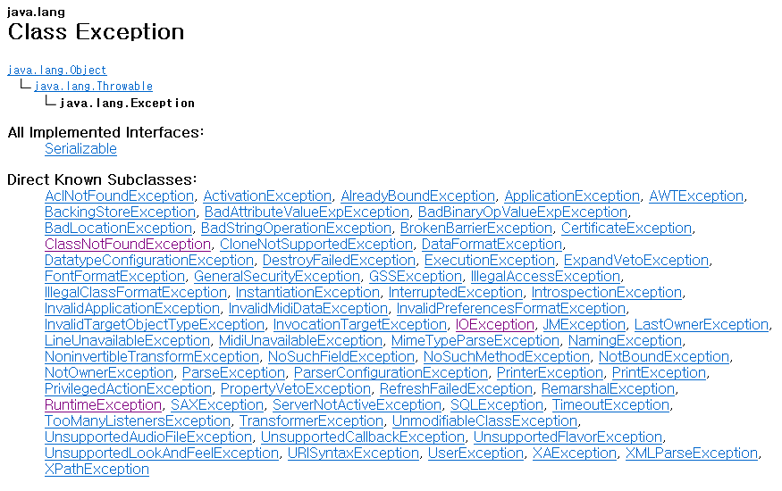
Subclasses of Exception

Slide 20
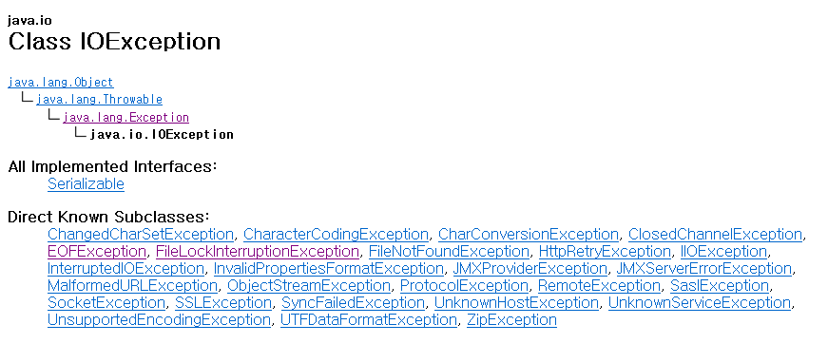
Subclasses of IOException

Slide 21
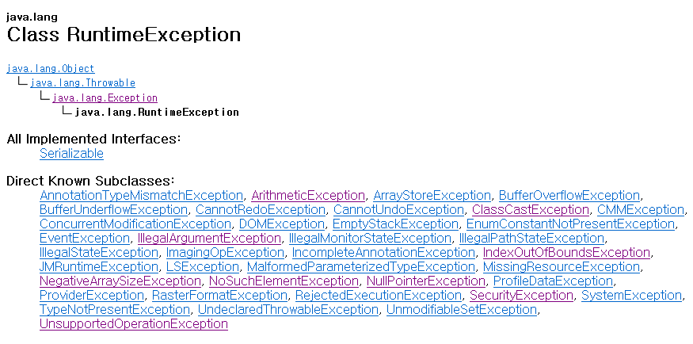
Subclasses of RuntimeException

Slide 22
The finally Block
The finally block always executes
public class FinallyBlock {
public static void main(String[] args) {
String[] array = {"First", "Second", "Third"};
List<String> list = new ArrayList<>(Arrays.asList(array));
PrintWriter out = null;
try {
System.err.println("Entering try statement");
out = new PrintWriter( new FileWriter("OutFile.txt"));
for (int i = 0; i < 10; i++) out.println("Value at: " + i + " = " + list.get(i));
} catch (IndexOutOfBoundsException e) {
System.err.println("Caught IndexOutOfBoundsException: " + e.getMessage());
} catch (IOException e) {
System.err.println("Caught IOException: " + e.getMessage());
} finally {
if (out != null) { System.err.println("Closing PrintWriter"); out.close(); }
else { System.err.println("PrintWriter not open"); }
}
}
}
Entering try statement
Caught IndexOutOfBoundsException: Index 3 out of bounds for length 3
Closing PrintWriter

Slide 23
Closing a File with Finally Block
You can use a finally block to ensure that a resource is closed regardless of whether the try statement completes normally or abruptly.
public static String readFirstLine(String path) throws IOException {
BufferedReader br = null;
String line = "";
try {
br = new BufferedReader(new FileReader(path));
line = br.readLine();
} finally {
if ( br != null ) br.close(); // may throw exception
}
return line;
}

Slide 24
The try-with-resources Statement (Since Java 7)
The try-with-resources statement ensures that each resource is closed at the end of the statement.
A resource: any object that implements java.lang.AutoCloseable can be used as a resource.
public static String readFirstLine(String path) throws IOException {
String line = "";
try (BufferedReader br = new BufferedReader(new FileReader(path)))
{
line = br.readLine();
}
return line;
}

Slide 25
User-defined Exceptions: definitions
Programmer can define new classes of exceptions by extending, commonly, the RuntimeException class.
class MyDivideByZeroException extends RuntimeException {
public String toString() {
return "Zero denominator used" ;
}
}
class MyArrayOutOfBoundsException extends RuntimeException {
private final int invalidIndex ;
public MyArrayOutOfBoundsException(int invalidIndex) {
this.invalidIndex = invalidIndex ;
}
public String toString() {
return String.format("Invalid Array Index: %d", invalidIndex) ;
}
}
Notes:
사용자 정의 예외 클래스는, Exception 또는 그 하위 클래스를 상속받아 정의한다.
클래스이므로 생성자, 필드 변수, 메소드를 가질 수 있다.

Slide 26
User-defined Exceptions: Throwing and Catching
public class UserDefinedException {
private static double badCode(int a[], int y) {
if ( y < 0 || y >= a.length ) throw new MyArrayOutOfBoundsException(y) ;
int x = a[y] ;
if ( x == 0 ) throw new MyDivideByZeroException() ;
return 1 / x ;
}
public static void main(String[] args) {
try {
int[] a = {0, 1, 2} ;
badCode(a, 5) ; // throw MyArrayOutOfBoundsException(y)
// badCode(a, 0) ; // throw MyDivideByZeroException()
}
catch (MyDivideByZeroException e ) { System.out.println(e) ; }
catch (MyArrayOutOfBoundsException e) { System.out.println(e) ; }
}
}

Slide 27
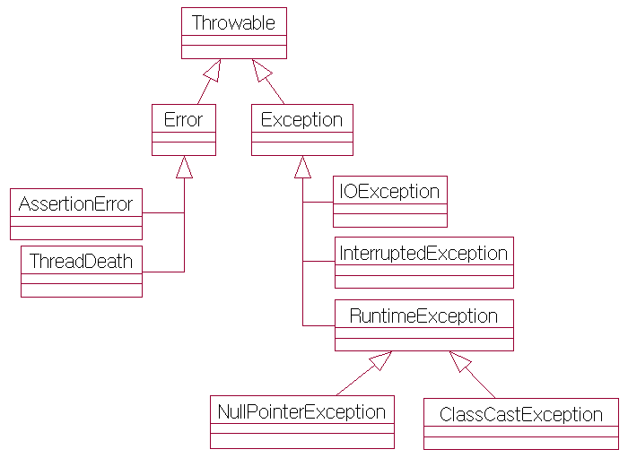
Types of Exceptions
Exceptions are classified into checked and unchecked
Checked
Any exception except RuntimeException
Need to take care at run-time
Unchecked
System’s error
Unchecked
Programmer’s errors

Slide 28
How to handle checked exceptions
For checked exceptions, you should catch them
class MyRangeException extends Exception { // checked
public String toString() { return “MyRangeException" ; }
}
class MyNumberException extends RuntimeException { // unchecked
public String toString() { return " MyNumberException " ; }
}
public class CheckedException {
public static void write() {
try {
FileReader fin = new FileReader("employee.txt");
// throw new MyNumberException() ;
throw new MyRangeException() ;
}
catch (IOException e) { … } // catching checked exception
catch (MyRangeException e) { … } // catching checked exception
}
}

Slide 29
How to handle checked exceptions
Or, you should re-throw, so that the caller can handle them
class MyRangeException extends Exception { // checked exception
public String toString() { return “MyRangeException" ; }
}
class MyNumberException extends RuntimeException { // unchecked exception
public String toString() { return " MyNumberException " ; }
}
public class CheckedException {
private static void write() throws IOException, MyRangeException {
FileReader fin = new FileReader("employee.txt");
// throw new MyNumberException();
throw new MyRangeException();
}
public static void main(String[] args) throws IOException, MyRangeException {
write() ;
}
}

Slide 30
How to handle checked exceptions
If there are no catch or rethrows for checked exceptions, compiler will issue an error message
public class CheckedException {
private static void write() {
FileReader fin = new FileReader("employee.txt") ;
// unhandled exception type FileNotFoundException
throw new MyNumberException() ;
throw new MyRangeException() ;
// unhandled exception type MyRangeException
}
}
public class CheckedException {
private static void write() throws IOException, MyRangeException {
FileReader fin = new FileReader("employee.txt") ;
throw new MyNumberException() ;
throw new MyRangeException() ;
}
public static void main(String[] args) {
write() ;
}
}

Slide 31
Not Handling an Exception
If a method raises an exception and it does not have a catch block or throws declaration then…
checked exception: the compiler will reject your code at compile time: You should catch or rethrows it !
unchecked exception: the program will terminate at runtime

Slide 32
Not Handling an Unchecked Exception
Unhandled unchecked exceptions
1: class MyNumberException extends RuntimeException {
2: public String toString() { return "MyNumberException" ; }
3: }
4: public class UncheckedException {
5: public static void main(String[] args) {
6: write() ; // not handle MyNumberException
7: }
8: public static void write() {
9: throw new MyNumberException() ;
10: }
}
Exception in thread "main" MyNumberException
at UncheckedException.write(UncheckedException.java:9)
at UncheckedException.main(UncheckedException.java:6)

Slide 33
Stack Trace Information
If no handler is called, then the system prints a stack trace as the program terminates
it is a list of the called methods that are waiting to return when the exception occurred
very useful for debugging/testing
The stack trace can also be printed by calling exception.printStackTrace()

Slide 34
01: public class UsingStackTrace {
02: public static void main( String args[] ) {
03: try { method1(); }
04: catch (Exception exception) {
05: System.err.println(exception.getMessage() + "\n");
06: exception.printStackTrace();
07: StackTraceElement[] traceElements = exception.getStackTrace();
08: System.out.println("\nStack trace from getStackTrace:");
09: System.out.println("Class\t\tFile\t\t\tLine\tMethod");
10: for ( int i = 0; i < traceElements.length; i++ ) {
11: StackTraceElement element = traceElements[ i ];
12: System.out.print(element.getClassName() + "\t");
13: System.out.print(element.getFileName() + "\t");
14: System.out.print(element.getLineNumber() + "\t");
15: System.out.print(element.getMethodName() + "\n");
16: }
17: }
18: }
19: public static void method1() throws Exception { method2(); }
20: public static void method2() throws Exception { method3(); }
21: public static void method3() throws Exception { throw new Exception( "Exception thrown in method3" ); }
}
The compiler will reject the program at compile time if the throws are not included because Exception is checked exception
Exception thrown in method3
java.lang.Exception: Exception thrown in method3
at UsingStackTrace.method3(UsingStackTrace.java:21)
at UsingStackTrace.method2(UsingStackTrace.java:20)
at UsingStackTrace.method1(UsingStackTrace.java:19)
at UsingStackTrace.main(UsingStackTrace.java:3)
Stack trace from getStackTrace:
Class File Line Method
UsingStackTrace UsingStackTrace.java 21 method3
UsingStackTrace UsingStackTrace.java 20 method2
UsingStackTrace UsingStackTrace.java 19 method1
UsingStackTrace UsingStackTrace.java 3 main

Slide 35
Using Assertions
With assertions, you can use assertions to check some conditions.
1: public class AssertTest {
2: public static void main(String args[]) {
3: assert args.length > 0 : "\nusage: java AssertTest <args>" ;
4: int i = 0;
5: do {
6: System.out.println(args[i]);
7: i++;
8: } while (i < args.length);
9: }
}
Exception in thread "main" java.lang.AssertionError:
usage: java AssertTest <args>
at AssertTest.main(AssertTest.java:3)

Slide 36
Using Assertions
Usages for assert
assert condition ;
assert condition : expression ;
Assertions can be enabled and disabled by –ea option (by default, they are turned off)
java –ea AssertTest
java –da AssertTest

Slide 37
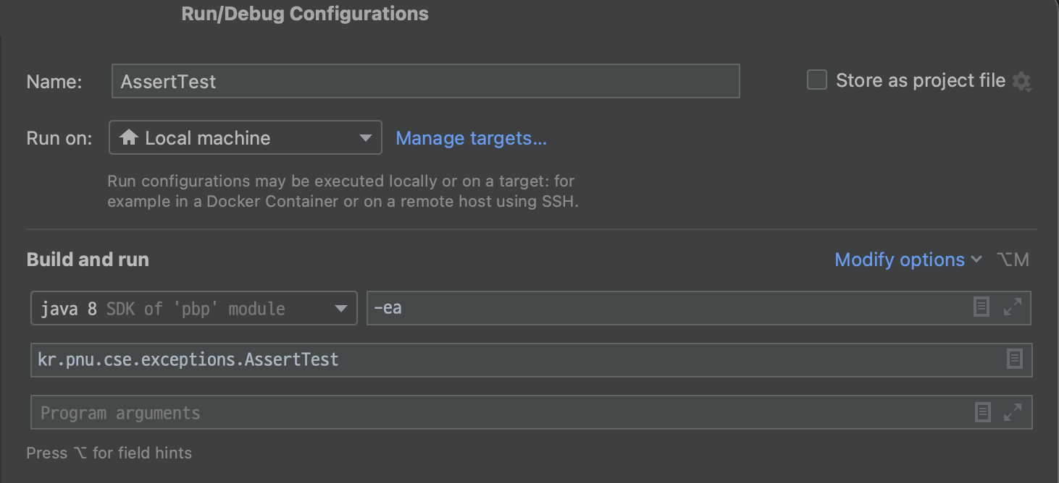
Enabling and Disabling assertions in IntelliJ
Menu > Run > Edit Configurations...
Modify options > Java Add VM options

Slide 38
Enabling and Disabling assertions: Comparison
When assertions are enabled; java –ea AssertTest
Exception in thread "main" java.lang.AssertionError:
usage: java AssertTest <args>
at AssertTest.main(AssertTest.java:3)
When assertions are disabled; java –da AssertTest
Exception in thread "main" java.lang.ArrayIndexOutOfBoundsException: Index 0 out of bounds for length 0
at AssertTest.main(AssertTest.java:6)

Slide 39
Checking Pre/post condition by assertions
Precondition: conditions that should be satisfied before the execution
Postcondition: conditions that should be satisfied after the execution
public class PrePostCondition {
public static void sort(int []a) {
assert a != null ; // precondition
for (int i = 0; i < a.length - 1; i++)
for (int j = i + 1; j < a.length - 1; j++)
if (a[i] < a[j]) {
int t = a[i]; a[i] = a[j]; a[j] = t;
}
for (int i = 0; i < a.length - 1; i ++) // postcondition
assert a[i] >= a[i+1] ;
}
public static void main(String[] args) {
int[] a = {0, 25, 20, 50} ;
sort(a) ;
}
}
Exception in thread "main" java.lang.AssertionError
at PrePostCondition.sort(PrePostCondition.java:12)
at PrePostCondition.main(PrePostCondition.java:16)

Slide 40
Q&A

